Slide 1
Rooted in the Word
HIM
Digging Deep – Colossians 2:6-7
Tim Munther
Pine Valley 2024

Slide 2
Motivating Passages
Colossians 2:6-7 6 As you therefore have received Christ Jesus the Lord, so walk in Him, 7 rooted and built up in Him and established in the faith, as you have been taught, abounding in it with thanksgiving.
Psalm 1:2-3 2 …[Blessed is the man whose]... delight is in the law of the Lord, and in His law he meditates day and night. 3 He shall be like a tree planted by the rivers of water, that brings forth its fruit in its season, whose leaf also shall not wither; and whatever he does shall prosper.
Notes:
Col 2:6-7
Received – received that which was passed down (i.e., tradition) by God’s apostles
Christ Jesus the Lord – not merely a tradition of behavior or belief, but a Person, which implies relationship
Walk – live, which includes speech, thought, action, purpose, motivation
in Him – following after Him in emulation of His character and truth as well as by His power and grace
Rooted – biologically connected to Him, implies He is the sustainer and giver of life (i.e., the Vine)
Built up – architecturally founded upon Him, implies solid foundation for life and purpose
Established in the faith – firmly convinced of His grace and truth wherein is all knowledge and wisdom
As you have been taught – i.e., received (v. 6) the foundation of Christ laid by God’s apostle
Abounding in it with thanksgiving – growing in knowledge and grace with gratitude and contentment because He is our treasure
Because Jesus is… Image of the invisible God – brightness of His glory and exact imprint of His person; Firstborn over all creation – position of preeminence over all creation; For by Him all things…before all things – Creator and Sustainer of all; Head of Body – Captain, Leader, Ruler of the Church; Firstborn from the dead – first to rise from the dead; In whom are hidden all the treasures of wisdom and knowledge – full of grace and truth; All the fullness of the Godhead bodily – Emmanuel, God with us; Head of all principality and power – omnipotent; Is all and in all – unifying Head to whom we look and indwelling power by which we work.
All this is contrasted with a love of apparent wisdom, which is really a worldly wisdom wherein is bitter envying and self-seeking. That philosophy is not a love of the wisdom and knowledge of Christ, but is predicated on human tradition rooted in Jewish mysticism, including legalistic interpretations of God’s law, worshipping angels, self-imposed religion, false humility, and neglect of the body, which are of no value against the indulgence of the flesh.

Slide 3

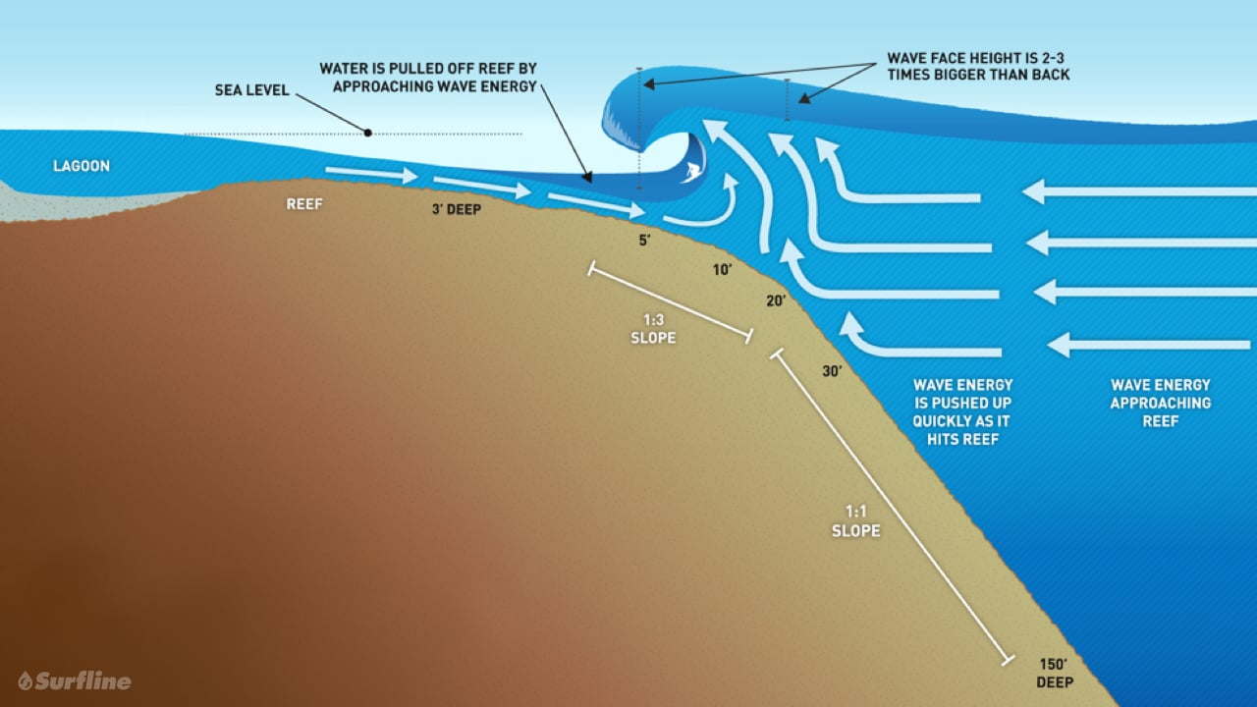
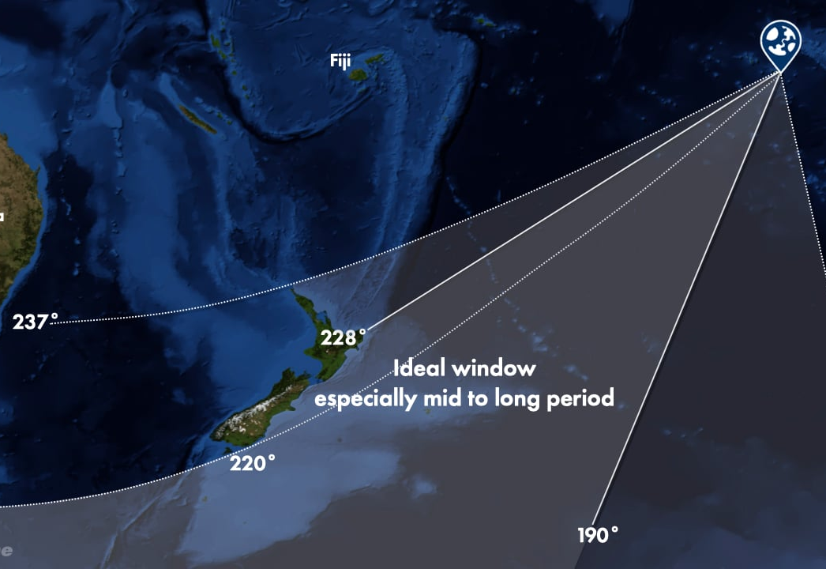
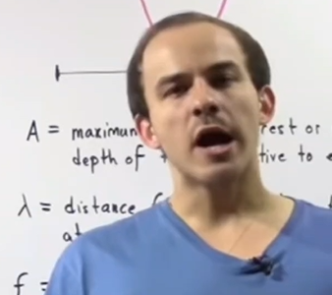
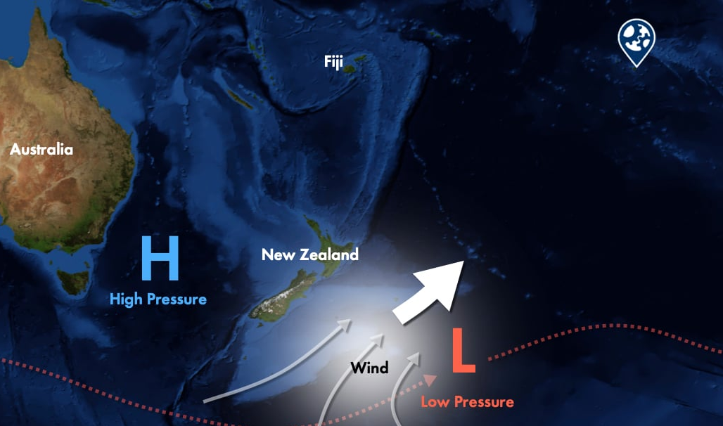
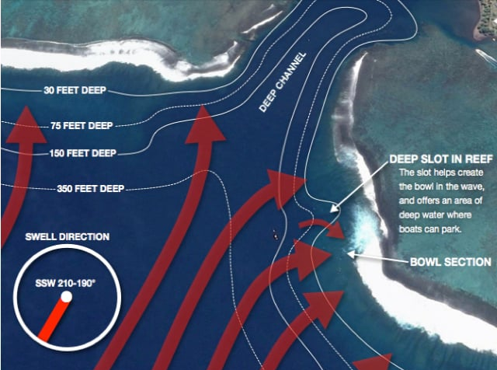
Surfers Students
Greetings Brother. You have no understanding. You cannot see passed your stoke… man.
Whoa bruh! You have no idea. Don’t weary me with all your math and models, man.
Image credit: https://www.surfer.com/features/keala-kennelly-it-swallowed-me-whole/
Image credit: https://www.surfline.com/surf-news/mechanics-of-teahupoo-tahiti-surf-worlds-heaviest-wave/31797
Combine “surfer” (one who experiences) and “student" (one who studies) so that the personal experience of the ocean is set in the context of bathymetry, currents, winds, swells, etc. resulting in a genuine love and accurate knowledge of the ocean.
Analogy developed from C.S. Lewis Mere Christianity
Notes:
At one extreme, there are those who primarily seek spiritual experiences and are not grounded in the Word. They look for symbols and signs. They throw out a fleece. They consider how the winds shifts or seek ambiguous feelings of stillness. They quote “Be still and know that I am God” yet fail to realize God has revealed Himself to be known through deep study of His word. This extreme is much more susceptible to spurious winds and waves “by the trickery of men, in the cunning craftiness of deceitful plotting” Ephesians 4:14.
At another extreme, there are those who study the scripture, determine its meaning, and even see how it ought to be applied. However, they don’t really know its meaning in the sense that they have not truly believed, obeyed, and experienced it. They may be able to talk about the love of God in an academic sense, but they really have no clue until they actually ride the wave and are immersed in the ocean of God’s love.
We seek to be rooted in Him… not by accident nor merely academics nor just a to do list… but that being rooted in Him would lead to a life of worshipful expression in every aspect of our lives.

Slide 4
Surfers Students
Romans 11:33-35 33 Oh, the depth of the riches both of the wisdom and knowledge of God! How unsearchable are His judgments and His ways past finding out! 34 “For who has known the mind of the Lord? Or who has become His counselor?” 35 “Or who has first given to Him And it shall be repaid to him?” 36 For of Him and through Him and to Him are all things, to whom be glory forever. Amen.
John 5:39 …these are they which testify of Me.
Worship Him in…
experience and sincerity of spirit
knowledge and application of truth
Hebrews 1:1-2 1 God, who at various times and in various ways spoke in time past to the fathers by the prophets, 2 has in these last days spoken to us by His Son…
Greetings Brother. You have no understanding. You cannot see passed your stoke… man.
Whoa bruh! You have no idea. Don’t weary me with all your math and models, man.
John 6:68 …Lord, to whom shall we go? You have the words of eternal life.
Deuteronomy 8:3 …man lives by every word that proceeds from the mouth of the Lord.
Image credit: https://www.surfer.com/features/keala-kennelly-it-swallowed-me-whole/
Image credit: https://www.surfline.com/surf-news/mechanics-of-teahupoo-tahiti-surf-worlds-heaviest-wave/31797
Combine “surfer” (one who experiences) and “student" (one who studies) so that the personal experience of the ocean is set in the context of bathymetry, currents, winds, swells, etc. resulting in a genuine love and accurate knowledge of the ocean.
Analogy developed from C.S. Lewis Mere Christianity
Notes:
Understand these verses come on the heels of the most thorough theological treatise in the Bible. It’s deep rooted in the knowledge of God. As Paul makes a stark transition from theology to practice, he (inspired by the Spirit) is overwhelmed with these awesome truths God that has revealed. Knowing these divine truths has brought him to a place where he stands in awe of God and erupts in praise. “The more you know, the more you realize you don’t know.” I feel like this is what’s going on in the mind of Paul. He has been given so much revelation and extrapolates to realize how much he doesn’t know.
As Jesus said to those opposing Him John 5:39, “these [OT scriptures] are they which testify of Me.” Consume the word of God. Drink deeply from the well of knowledge and wisdom.
Hebrews 1:1-2 1 God, who at various times and in various ways spoke in time past to the fathers by the prophets, 2 has in these last days spoken to us by His Son…” He has spoken so that we can know Him! Realize the amazing gift we hold in our hands. I’ve often heard of believers in countries where the Bible is prohibited. They crave the Word of God in a way that actually regards God’s word as it ought to be regarded.
When Jesus gave some hard saying to an large audience in John 6, some stopped following Him, and he posed this question to the 12… “Do you also want to go away?” To which Peter responds in John 6:68 …Lord, to whom shall we go? You have the words of eternal life.
Deut 8:3 Man lives by every word that proceeds from the mouth of the Lord.

Slide 5
Ground Rules and Assumptions
(agreements about scripture to ground our discussion)
Progressive revelation and compilation of 66 canonical books (39 OT / 27 NT) broadly recognized by those faithful to God
Scriptural autographs (original manuscripts, not copies or translations) are…
  Infallible – cannot err
  Inerrant – contains no errors
  Inspired – message is God-breathed (while maintaining personality of author)
Perspicuous (clear / comprehensible) though not necessarily easy (2 Peter 3:15-16)
Sufficient (not exhaustive) to know God, ourselves, salvation, faith, purpose, etc.
Faithfully preserved and transmitted
Sola Scriptura – scriptures are the final, ultimate, supreme (not only) authority
Notes:
2 Peter 3:15-16 15 …our beloved brother Paul, according to the wisdom given to him, has written to you, 16 as also in all his epistles, speaking in them of these things, in which are some things hard to understand, which untaught and unstable people twist to their own destruction, as they do also the rest of the Scriptures.
Wayne A. Grudem, “The Perspicuity of Scripture,” Themelios 34.3 (2009): 288–309.
Not all at once;
Not without effort;
Not without ordinary means;
Not without the reader’s willingness to obey it;
Not without the help of the Holy Spirit;
Not without human misunderstanding;
Never completely.
When people quote… “not even a fool can err” it’s not only a misquotation from Isaiah 35:8, it’s also a misunderstanding of the statement. The term fool (esp. in OT) is most often used to describe a person’s moral condition not their intellectual. The fool says in his heart there is no God, not because he’s stupid, but because he is evil. As Psalm 14 continues… this fool is corrupt and has done abominable works… etc.

Slide 6
Radio Waves and Noise
(we actually have the scriptures)
Some had errors.
Don’t miss the forest for the tree…
we have the scriptures!
Multiple copies compared to form an…
Scribes made copies.
… almost perfect signal
Some were destroyed.
Notes:
Skeptics often criticize the bible as made up stories manipulated and changed throughout history like a giant game of telephone. That couldn’t be further from the truth.

Slide 7
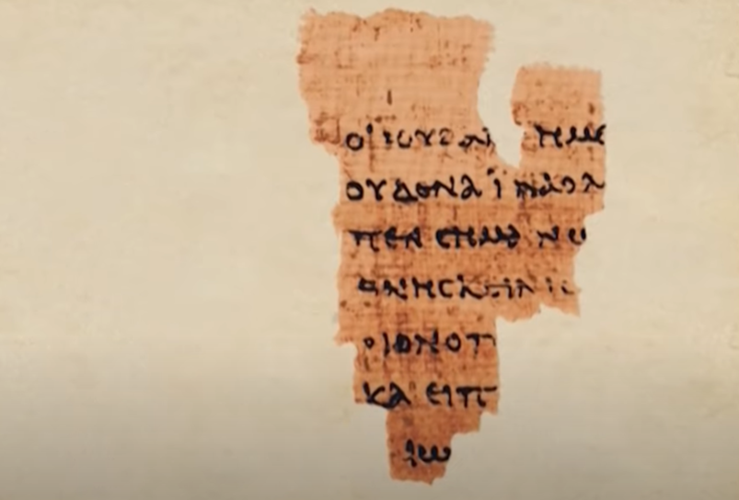
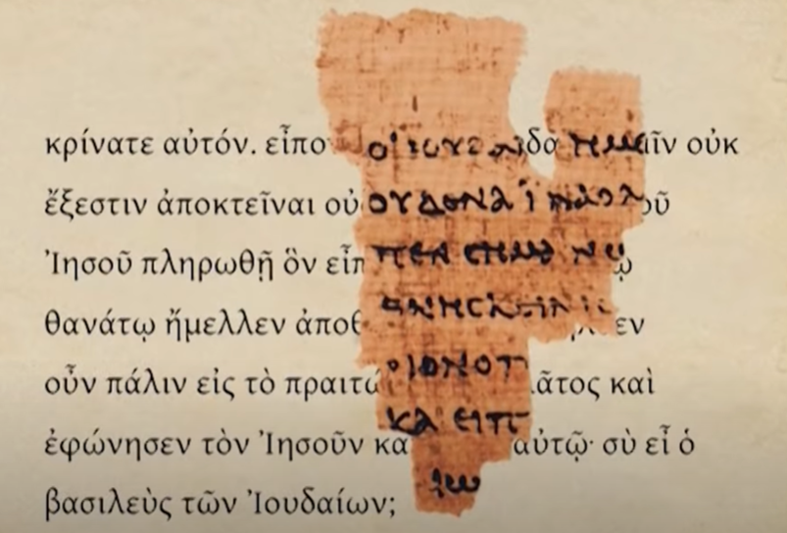
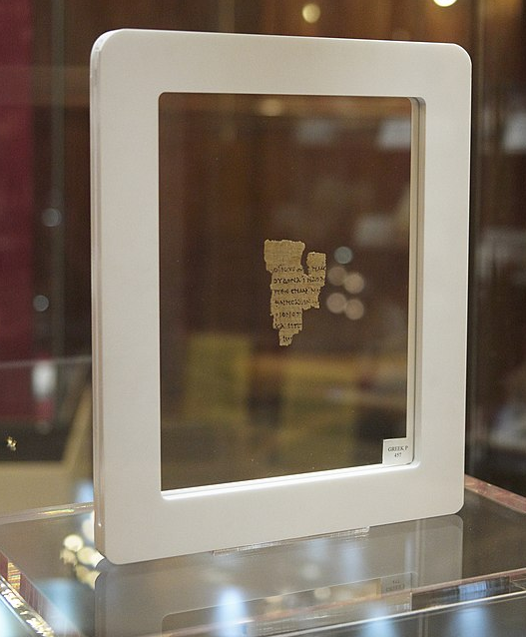
Radio Waves and Noise
(we actually have the scriptures)
John 18:31-33 …the Jews, “For us it is not permitted to kill anyone,” so that the word of Jesus might be fulfilled, which he spoke signifying what kind of death he was going to die. Entered therefore again into the Praetorium Pilate and summoned Jesus and said to him, “Thou art king of the Jews?”
John 18:31-33 …the Jews, “For us it is not permitted to kill anyone,” so that the word of Jesus might be fulfilled, which he spoke signifying what kind of death he was going to die. Entered therefore again into the Praetorium Pilate and summoned Jesus and said to him, “Thou art king of the Jews?”
Image credit https://www.youtube.com/watch?v=moHInA9fAsI
Rylands Library Papyrus P52 dated to the 1st to 2nd century
Image credit: https://en.wikipedia.org/wiki/Rylands_Library_Papyrus_P52#/media/File:JRL19060215.jpg
Notes:
Skeptics scoff at “manuscripts” like P52 saying, “That’s all you have?” Negative sir. There are thousands upon thousands of manuscripts, many of which contain significant portions of passages and books. Despite not having the originals, the very early dates, geographic dissemination, close correlation, and the fact that these thousands of manuscripts were not under the direct control of one ruling tyrant or governing body forms a most solid foundation that God’s word has been faithfully preserved and accurately transmitted throughout history. It is not a wild game of telephone. Rather, the Bible is the most historically reliable ancient text lightyears beyond any other.

Slide 8
For What Sayeth the Scripture?
(the most reasonable hermeneutic)
Historical-grammatical hermeneutic = most reasonable interpretative approach to scripture because it seeks to find the intended and objective meaning of the text by means of historical context and grammatical rules.
  Meaning of a passage is one though the significance and application may be many
Historical – there is a historical context in which the scriptures were written
  Culture, geography, audience, author, time
Grammatical – we communicate by grammatical rules of language
  Literary form: poetry, proverbs, history, prophesy, apocalyptic, parables, didactic (prescriptive), etc.
  Context, purpose, word usage, patterns, themes, etc.
  Structure, verb tense, subject, object, adjectives, adverbs, prepositions, etc.
Notes:
Don’t need to perform some ritual and enter into a trance to find the meaning behind the text.
Don’t need a super computer to run complex pattern matching algorithms to find hidden messages
Historical-grammatical hermeneutic… don’t assert ourselves as critics over and above the Bible (appears to be associated with a historical-critical hermeneutic). Rather, we submit to the authority of the Bible and attempt to understand its message by rules of grammar and context. Therefore, it’s good to study geography, history, culture, language, archeology, etc. and bring those extra-biblical inputs to bear when trying to understand its message.

Slide 9

For What Sayeth the Scripture?
(the most reasonable hermeneutic)
EXAMPLE: You are only half done. Please finish dusting the kifle with powdered sugar.
EXAMPLE: You are only half done. Please finish dusting
Imperative (command)
What is the sentence type?
Who is the subject?
What is being commanded?
What could the word “finish” imply?
What are you supposed to dust?
Implied subject is you because form is imperative
Dust to point of completion
Started but incomplete OR not started
Can’t know without more context. Also, when you dust could be adding fine particles or removing fine particles (dust is a contranym).
Literal interpretation = determine the one meaning conveyed by grammatical construction and context
Amelia Bedelia – books about a character who misunderstands figures of speech (e.g., dust furniture, draw curtains, change the towels)
Image credit: https://www.mindfulmuslimreader.com/wp-content/uploads/2022/10/amelia-bedelia.jpeg
Notes:
Amelia Bedelia literally interprets her instructions, but she literally gets them incorrect. Literal interpretation takes into account the literary type and context to properly interpret.

Slide 10
For What Sayeth the Scripture?
(the most reasonable hermeneutic)
In order to understand, it must be translated to a language you understand…
Greek Textus Receptus: ουτως γαρ ηγαπησεν ο θεος τον κοσμον ωστε τον υιον αυτου τον μονογενη εδωκεν ινα πας ο πιστευων εις αυτον μη αποληται αλλ εχη ζωην αιωνιον
Latin Vulgate: sic enim dilexit Deus mundum ut Filium suum unigenitum daret ut omnis qui credit in eum non pereat sed habeat vitam aeternam
Nehemiah 8:8 So they read distinctly from the book, in the Law of God; and they gave the sense, and helped them to understand the reading.
1534 Tyndale: For God so loveth the worlde yt he hath geven his only sonne that none that beleve in him shuld perisshe: but shuld have everlastinge lyfe.
1st Edition 1611 KJV: For God so loued ye world, that he gaue his only begotten Sonne: that whosoeuer beleeueth in him, should not perish, but haue euerlasting life.
KJV: For God so loved the world, that he gave his only begotten Son, that whosoever believeth in him should not perish, but have everlasting life.
NASB: For God so loved the world, that he gave his only Son, that whoever believes in him should not perish but have eternal life.
Notes:
Nehemiah 8:8 provides us an example of the guiding principle by which we ought to approach the scriptures. We distinctly read it in an intelligible way to understand the sense of it and help others understand it too. This has implications not only how we approach the scriptures, but also the need to translate the scriptures into other languages so others can understand.
The religious elite of the Roman catholic church controlled the interpretation and application of scripture because most could not read other languages like Greek or Latin. William Tyndale fought and died (strangled and then burned at the stake) for the right to print the Bible in the English of his day. He said, "I defy the pope, and all his laws;" and added, "If God spared him life, ere many years he would cause a boy that driveth the plough to know more of the Scripture than he did." (quote taken from https://archive.org/stream/foxesbookofmartyrs_201708/Foxes-Book-of-Martyrs_djvu.txt). This does not imply a translation composed of figures of speech or colloquialisms that come and go in a generation. His intent was to have an accurate and intelligible translation such that the plowboy could understand.

Slide 11
Tips
(practical points to keep in mind)
Use the Bible to interpret the Bible. Use clearer passages to help understand obscure passages.
Consult dictionaries, lexicons, commentaries, other tools (e.g., blueletterbible).
Sometimes literary types are mixed together (e.g., 1 Sam 2).
Respect thousands of years of believers struggling to understand and apply the Bible.
Keep an open mind (e.g., Bereans in Acts 17:11), but not too open that your brains fall out.
Always keep the Bible as the primary authority (Sola Scriptura).
“Man’s interpretation” vs. “God’s pure word” is a false dichotomy. Always some interpretation.
Compare your understanding against others.
Don’t only read things that you agree with.
Don’t only talk to people that you agree with.
Be honest in your pursuit of understanding.
Acknowledge your bias and tradition!
Pray that God would give you insight and clarity.
Don’t rely on ambiguous feelings of “peace.”
Don’t use symbols and signs to guide you.
When considering the nature of God, realize that you are a finite being trying to grasp the one and only infinite being. Therefore, it is appropriate to allow for mystery (not contradiction) in your appreciation of God.
Notes:
Tell me how does a Christian begin To develop discernment and wisdom First we submit every symbol and sign To the authority of the scriptures… But I say the mark of a mature man Is the one who reads God's Word and understands And allows that to govern his decisions and his prospective plans. https://genius.com/Beautiful-eulogy-symbols-and-signs-lyrics

Slide 12


Super PitFall(s)
(common interpretive errors)
Allegorizing and spiritualizing – symbolic and/or spiritual interpretations not grounded in the text
Eisegesis – reading into the text what you want it to mean (in contrast to exegesis)
Ignoring context – selecting what you like and rejecting what you don’t like
Personal meaning – “what does this mean to you”
Not realizing bias – we all have experience and bias
Random readings – treating the Bible like a magic book
Interpreting in isolation – just me and my Bible
https://alchetron.com/cdn/super-pitfall-5043a385-a287-4865-82d7-854b6e09326-resize-750.jpg
https://i.pinimg.com/originals/49/bb/35/49bb356eee56c8b34915402f516a8cc1.jpg

Slide 13
How Do You Do What?
(practice session)
Exodus 20:15 You shall not steal
Key interpretative tool… use clear, natural reading and consider importance / applicability due to how often repeated
Notes:
Author is Moses to ancient Israel. The context is Moses giving God’s law to Israel, specifically the 10 commandments on stone tablets that act as a high level summary of God’s revealed law. This text is a clear imperative prohibiting stealing. Other passages that cite this prohibition include Exodus 22:7, Leviticus 19:13, 1 Corinthians 6:10, Ephesians 4:28, many more. The significance and application of this verse is that it is a clear imperative to God’s people Israel to not steal. It is one of the 10 commandments, and corresponds with God’s standard of morality in general. This command appears in one form or another in many other passages throughout OT and NT. Don’t take stuff that does not belong to you by fraud or force, whether it’s an ox, donkey, money, kidnaping, downloads, ideas, test answers, office supplies, etc., etc., etc. Key interpretative tool… read it as it naturally appears and consider the wide breath of applicability based on how often this command is stated and restated in scripture.

Slide 14
How Do You Do What?
(practice session)
Proverbs 22:6 Train up a child in the way he should go, and when he is old he will not depart from it.
Key interpretative tool… consider the type of literature
Notes:
The author is Solomon, and this is written to ancient Israel, but because it’s within a book that is a compilation of wise proverbial sayings, the intended audience is anyone and everyone who desires wisdom (see first few chapters of proverbs). This verse is a proverb, which serves as a wise saying or principle that is generally true.
“Train up” = positive connotation of initiate/dedicate (dedicate home our house of God – Deu 20:5, 1 Kings 8:63, 2 Ch 7:5).
“the way” = path, road, trajectory
“he should go” = most often translated as mouth (as in mouth or opening of a well)… combined with “way” could mean the “opening of his way”. The word “should” conveys an ought, as in this is the right path, which makes sense in the positive context of the word “dedicate.”
My translation… Dedicate the start of a child’s path in the way of proverbial wisdom (context of book of proverbs), and as he matures he will most likely not stray, but remain in that path of wisdom.
Unfortunately, this verse does not appear in the Septuagint (Greek is generally more specific than Hebrew). But other verses to consider that are similar to this proverb include: Proverbs 22:15 Foolishness is bound up in the heart of a child; The rod of correction will drive it far from him; Ephesians 6:4 And you, fathers, do not provoke your children to wrath, but bring them up in the training and admonition of the Lord; 2 Timothy 3:14-15 14 But you must continue in the things which you have learned and been assured of, knowing from whom you have learned them, 15 and that from childhood you have known the Holy Scriptures, which are able to make you wise for salvation through faith which is in Christ Jesus.
The significance and application of this verse is that it is a principle to live by, esp. as a parent. Realize that the investment in a child’s early upbringing (mouth/start of his way) has great potential to pay dividends as they age and take responsibility for their own life. It will be an exception that they depart from the way in which they were dedicated/trained as a youth. This, however, is not a divine, hard and fast promise without exception. It is a proverb and should be regarded as such. There are exceptions to the rule at times.
Key interpretive tool… consider the type of literature

Slide 15
How Do You Do What?
(practice session)
Psalm 19:4-6 4 …He has set a tabernacle for the sun, 5 which is like a bridegroom coming out of his chamber, and rejoices like a strong man to run its race. 6 Its rising is from one end of the heave, and its circuit to the other end…
Key interpretative tool… consider the type of literature
Notes:
David is writing a song, which employes metaphors and similes. It’s poetic in nature. Furthermore, he’s writing from his perspective not from outer space. Therefore, when we read about the “circuit” the sun is making we ought not necessarily conclude that this verse teaches a geocentric solar system. Even in our scientifically advanced age in which we know the earth rotates and orbits the sun, we still say that the sun rises and sets because it makes sense from our perspective from Earth. It is foolishness to indict the Bible as being unscientific or misleading in this verse because of the type of literature and that it’s written in a way that the intended audience would best understand.

Slide 16
How Do You Do What?
(practice session)
Isaiah 55:1,7-9 “Ho! Everyone who thirsts,
Come to the waters… 7 Let the wicked forsake his way, And the unrighteous man his thoughts; Let him return to the Lord, And He will have mercy on him; And to our God, For He will abundantly pardon. Isaiah 55:8-9 8“For My thoughts are not your thoughts, Nor are your ways My ways,” says the Lord. 9 “For as the heavens are higher than the earth, So are My ways higher than your ways, And My thoughts than your thoughts.
Isaiah 55:1,7-9 “Ho! Everyone who thirsts,
Come to the waters… 7 Let the wicked forsake his way, And the unrighteous man his thoughts; Let him return to the Lord, And He will have mercy on him; And to our God, For He will abundantly pardon. Isaiah 55:8-9 8“For My thoughts are not your thoughts, Nor are your ways My ways,” says the Lord. 9 “For as the heavens are higher than the earth, So are My ways higher than your ways, And My thoughts than your thoughts.
Psalm 103:10 He has not dealt with us according to our sins, Nor punished us according to our iniquities. 11 For as the heavens are high above the earth, So great is His mercy toward those who fear Him.
Psalm 57:10 For Your mercy reaches unto the heavens, And Your truth unto the clouds.
Key interpretative tool… understand within immediate context and compare to other passages that use similar phrases
Notes:
God’s ways are higher than our ways… context is not about trying to understand mysteries of the world or a difficult passage in scripture. The point was that God’s grace and mercy are fare beyond our understanding. Think of Romans 5:20… where sin abounded grace abounded much more
.

Slide 17
How Do You Do What?
(practice session)
1 Corinthians 2:6-10 6 However, we speak wisdom among those who are mature, yet not the wisdom of this age, nor of the rulers of this age, who are coming to nothing. 7 But we speak the wisdom of God in a mystery, the hidden wisdom which God ordained before the ages for our glory, 8 which none of the rulers of this age knew; for had they known, they would not have crucified the Lord of glory. 1 Corinthians 2:9 But as it is written: “Eye has not seen, nor ear heard, Nor have entered into the heart of man The things which God has prepared for those who love Him.” 10 But God has revealed them to us through His Spirit. For the Spirit searches all things, yes, the deep things of God.
1 Corinthians 2:6-10 6 However, we speak wisdom among those who are mature, yet not the wisdom of this age, nor of the rulers of this age, who are coming to nothing. 7 But we speak the wisdom of God in a mystery, the hidden wisdom which God ordained before the ages for our glory, 8 which none of the rulers of this age knew; for had they known, they would not have crucified the Lord of glory. 1 Corinthians 2:9 But as it is written: “Eye has not seen, nor ear heard, Nor have entered into the heart of man The things which God has prepared for those who love Him.” 10 But God has revealed them to us through His Spirit. For the Spirit searches all things, yes, the deep things of God.
Isaiah 64:4 For since the beginning of the world Men have not heard nor perceived by the ear, Nor has the eye seen any God besides You, Who acts for the one who waits for Him.
Key interpretative tool… look up OT references and understand immediate context
Notes:
This is not about heaven, but about the mystery of the gospel. God Himself came down to reconcile the world to Himself. OT prophetic word has not been fulfilled. It has not been revealed… not just in space-time history, but revealed convincingly to our hearts and minds by God’s spirit. Yes, the new heaven and new earth will mind-blowing and amazing, but this verse is not directly speaking to that idea, and we should respect the word for what it’s actually saying.

Slide 18
How Do You Do What?
(practice session)
James 1:5 If any of you lacks wisdom, let him ask of God, who gives to all liberally (generously)…
2 Corinthians 8:2 that in a great trial of affliction the abundance of their joy and their deep poverty abounded in the riches of their liberality (generously)…
Matthew 6:19-24 19 Lay not up for yourselves treasures upon earth, where moth and rust doth corrupt, and where thieves break through and steal: 20 But lay up for yourselves treasures in heaven, where neither moth nor rust doth corrupt, and where thieves do not break through nor steal: 21 For where your treasure is, there will your heart be also. Matthew 6:22-23 23 The light of the body is the eye: if therefore thine eye be single, thy whole body shall be full of light. 23 But if thine eye be evil, thy whole body shall be full of darkness. If therefore the light that is in thee be darkness, how great is that darkness! 24 No man can serve two masters: for either he will hate the one, and love the other; or else he will hold to the one, and despise the other. Ye cannot serve God and mammon.
Matthew 6:19-24 19 Lay not up for yourselves treasures upon earth, where moth and rust doth corrupt, and where thieves break through and steal: 20 But lay up for yourselves treasures in heaven, where neither moth nor rust doth corrupt, and where thieves do not break through nor steal: 21 For where your treasure is, there will your heart be also. Matthew 6:22-23 23 The light of the body is the eye: if therefore thine eye be single, thy whole body shall be full of light. 23 But if thine eye be evil, thy whole body shall be full of darkness. If therefore the light that is in thee be darkness, how great is that darkness! 24 No man can serve two masters: for either he will hate the one, and love the other; or else he will hold to the one, and despise the other. Ye cannot serve God and mammon.
Deuteronomy 15:9 Beware lest there be a wicked thought in your heart, saying, ‘The seventh year, the year of release, is at hand,’ and your eye be evil against your poor brother and you give him nothing, and he cry out to the Lord against you, and it become sin among you.…
Matthew 20:14-15 14 Take what is yours and go your way. I wish to give to this last man the same as to you. 15 Is it not lawful for me to do what I wish with my own things? Or is your eye evil because I am good?’
Proverbs 28:22 A man with an evil eye hastens after riches...
Key interpretative tool… use the Bible to interpret the Bible
Notes:
The author is Matthew who is recording the words of Jesus. He was talking to primarily to 1st century Jews in Israel but, more specifically, to those who were at least intrigued to hear Jesus and others deeply committed. The historical context is 1st century Jews in Israel under Roman rule. God has not spoken through a prophet for ~400 years until John the Baptist. Jesus is now on the scene and making a huge impact as His reputation of a miracle worker and authoritative teacher is spreading. The form of these verses are didactic (teaching/instructive), but appears to be using of some kind of metaphor regarding light, darkness, eyes, and body.
Light = display of God glorifying behaviors… Matthew 5:14,15,16… Matthew 5:15 Let your light so shine before men, that they may see your good works, and glorify your Father which is in heaven.
Darkness = seems to depict something bad / negative. Can’t see in the dark. Seems to fit with mentioning the eye.
Eye = light (lamp) of the body… perhaps some indication of the character of the person… how they see / perceive others around them.
Single = adjective used to describe this eye that lights up the body… means undivided, properly folded.
Evil = bad
First the immediate context. It’s about loving money vs loving God. It’s about what we treasure. What does an single vs evil eye mean in that context and how does it either light up or darken the rest of our body?
Compare to another passage within Matthew that uses the same “evil eye” phrase. Consider other OT passages that that mention this evil eye, we can better understand what is meant by this Jewish idiom.
“Single” is an adjective describing the eye. Consider other passages that use the same Greek root, but in it adverbial form.
If we put this together along with the context that Jesus is talking about loving money vs loving God we find that…
Good/single eye = sees in a sincere and generous way… indicative of a heart that is loves God.
Evil eye = sees in a selfish and stingy way… indicative of a heart that loves money.

Slide 19
Concluding Thoughts
Deuteronomy 8:3 …man shall not live by bread alone; but man lives by every word that proceeds from the mouth of the Lord.
Notes:
I want us to consider our physical need to eat food. Excluding intentional fasting, it’s silly to purposely go days without eating. We need to eat. In light of Deut 8:3, it is very reasonable to ask the question, how long would you go without eating the Word? Consider the amazing fact that God’s has spoken and that we have access to His word that has been faithfully preserved and that we can know Him and ourselves because of it. How much time do we spend working for, planning, preparing our food? We often eat 3 square meals a day with some snacks in between. We take pictures of our food and send to friends and family. Those who prepare food for others learn by practice and mentorship whereas some get formal schooling. When baking a cake, sugar is considered a wet ingredient and if you don’t believe that it you’ll bear the consequences.
The comparison in Deut 8:3 is just too appropriate. It is absolutely essential to have intentional, daily, disciplined study of God’s word. And it’s not just a grind. It’s like baking a cake. When you learn it you get to enjoy it. It’s more blessed to give than to receive is not an opinion, it’s an eternal truth founded in the very nature of God. Read, memorize, mediate, and immerse yourself in God’s word.
I recommend studies to be primarily within a book. Topical studies can be dangerous, especially for beginners. Set aside time. Use the tools / tips. Find the objective meaning of the text and pray that God would open your eyes to see how it applies to your life in terms of belief and/or behavior. Expose yourself to the entire Bible. A great way to do that is to simply listen while you’re driving. I’ve gone through the Bible several years in a row now and the majority of that is by listening while I drive. I want Deuteronomy 8:3 to resonate in our hearts and minds. That it would move us to dig deep into God’s Word so that we would be firmly rooted in Him.

